Slide 1

FIRE
Financial Independence, Retire Early
VISHAL DALAL – Certified Financial Planner [CFP^{CM}]

Slide 2

Contents
FIRE Pre-Requisites & Process
Retirement Corpus Determination Example
Asset Classes & Products Walkthrough

Slide 3
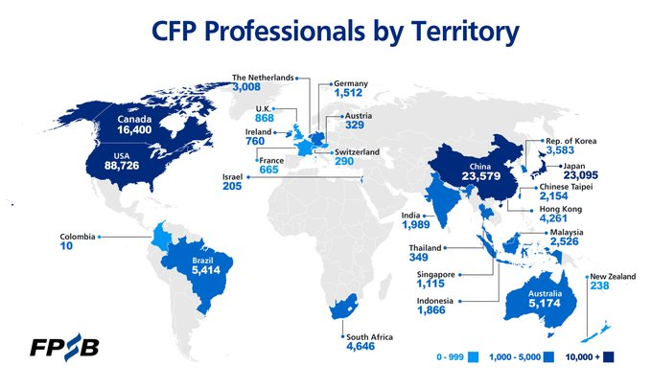
Who are we?
Certified Financial Planner - internationally recognized
24 years corporate experience (17+ in Fortune 500 banks)
Achieved FIRE, quit corporate job in Dec’23 @ age of 47 ☺

Slide 4
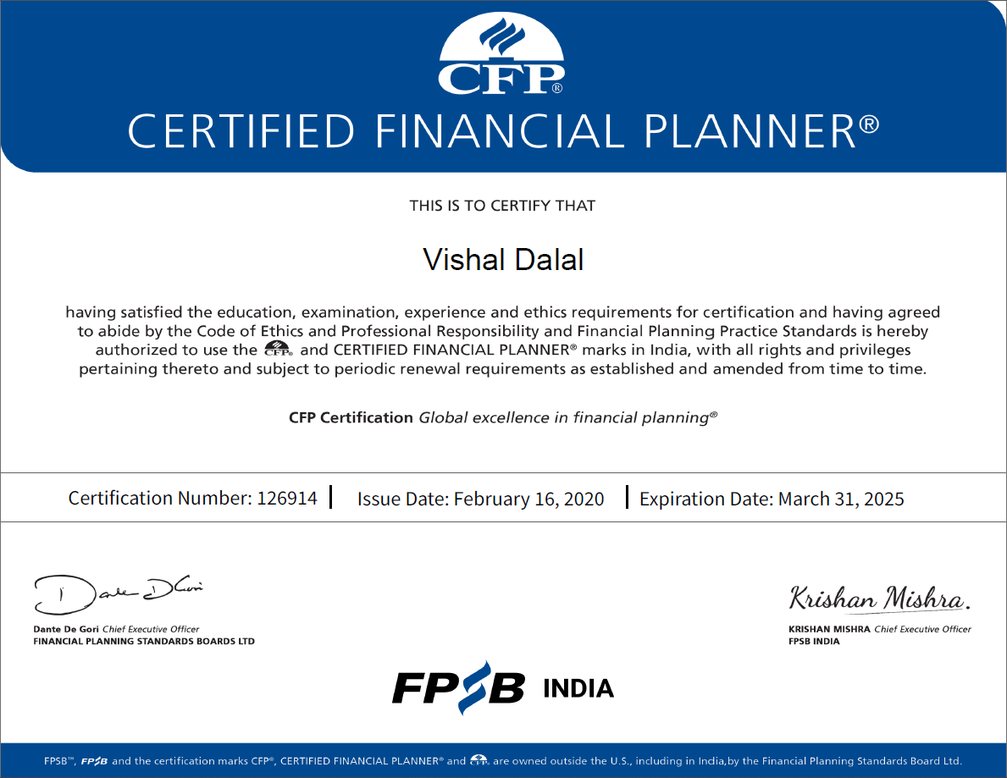

Slide 5
Pre-requisites for FIRE : Pre-Retirement
  Savings and control on expenses
  Higher income helps but not mandatory
  Disciplined investing
  Clear and objective financial goals
  Financial plan for a holistic view
  Realistic assumptions
  Post-retirement activity to keep oneself engaged

Slide 6
Pre-requisites for FIRE : Post-Retirement
  Have a health plan handy for 15 lakhs minimum
  Adherence by-and-large to planned expenses
  Be wary of ad-hoc / impulsive bulk expenses
  Do not fall prey to marketing gimmicks / scams
  Marked reduction in risk
  Monitor and track investments closely
  Do not take on new liabilities
  Ensure you spend at least 4-5 hours per day in productive activity (even if it is not remunerative)

Slide 7
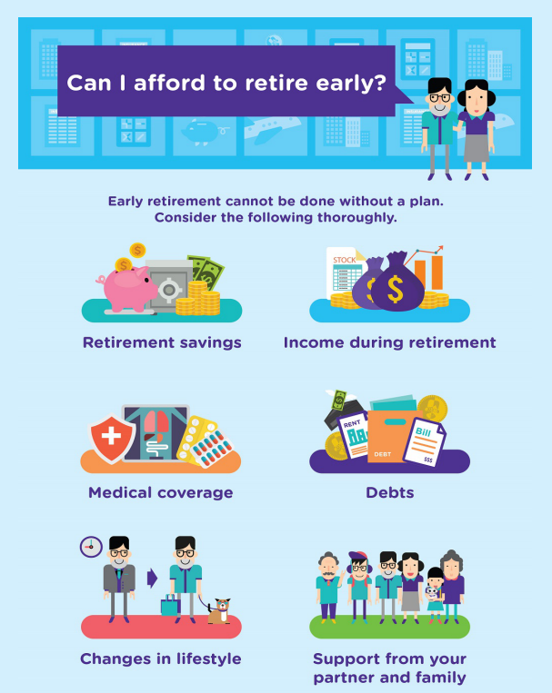
Pre-requisites for FIRE : Summary

Slide 8
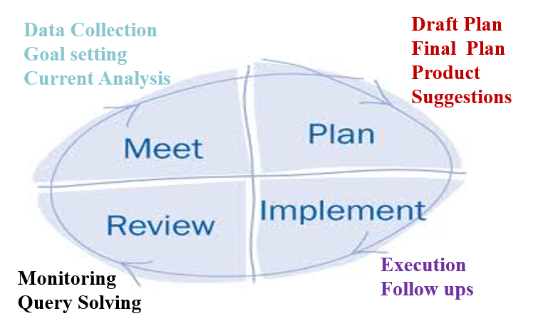
FIRE Process Workflow

Slide 9
Data Collection
Collate data points
  List all Financial Goals (incl FIRE) and priority
  Regular and Bulk expenses
  Current assets and liabilities
  Post-retirement income, such as pension / annuities
  Consider inheritance, if any
  Bequeath of assets to children / others, if any
Have a plan in mind for post-retirement activity - ideally something that does NOT require capital

Slide 10
Assumptions
Make a list of assumptions
  Lifespan (typically considered as 80 or 85 years)
  General & Specific inflation (Edu, Travel, etc.)
  Returns and appreciation value of investments
  Salary / Business income increment (leading up to retirement)
  Changes in post-retirement expenses, if any
  Spillover of liabilities, if any, at time of retirement
Document data points and assumption
  Excel is ideal
  Pen & Paper is also fine

Slide 11
Analysis & Planning
Create a financial plan using data points & assumptions
Fin Plan to cover the following at a minimum:
  Required retirement corpus at planned age
  Investments, emergency funding, liquidity
  Risk management via asset allocation
  Projected cashflows up to assumed lifespan
  Allow for ‘what-if’ scenario simulation
  Plot an age vs retirement chart to check if early retirement is possible if goals are rejigged later
  Tax Optimization

Slide 12
Corpus Determination - Example
Couple | Both aged 60 years
Current & Projected Expenses @ age 60 | Regular: 50,000 / month, increasing with inflation Bulk: Single child’s marriage @ age 65. Value: 35 lakhs
Post-Retirement Income | 20,000 pension pm until life, increasing with inflation
Bequeath to children | Existing premises
Inflation | Assumed @ 6% until lifetime
Lifespan / Longevity | Assumed up to 80 years
Risk Quotient & Investment of Corpus | Moderate Risk Suggested Allocation: 50% Debt, 30% Equity, 20% Gold

Slide 13
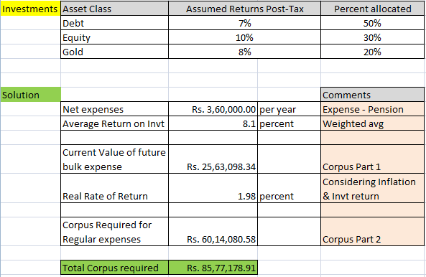
Corpus Determination – Summary Solution

Slide 14
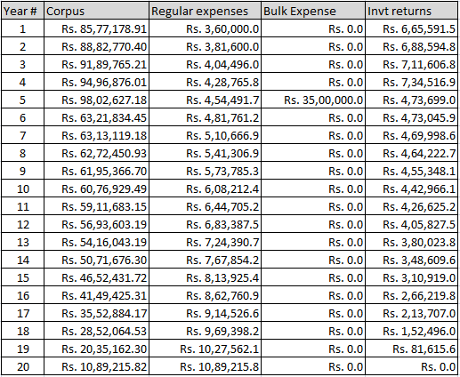
Corpus Determination - Details

Slide 15
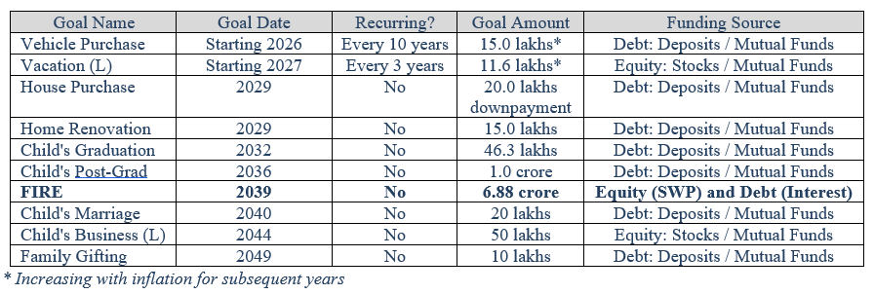
Example: Integrating FIRE with other goals
Brief Background
  Family of three; husband sole earner
  Current age of husband: 35 years
  Goals as below; FIRE @ age of 50 years

Slide 16
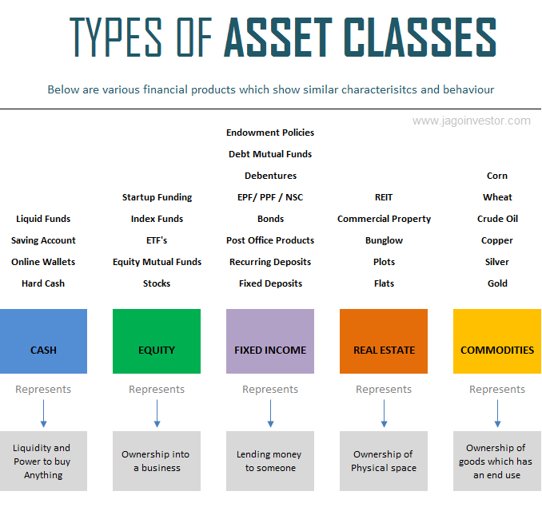

Slide 17
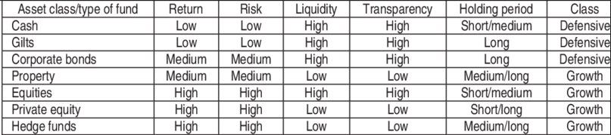
Key characteristics of asset classes

Slide 18
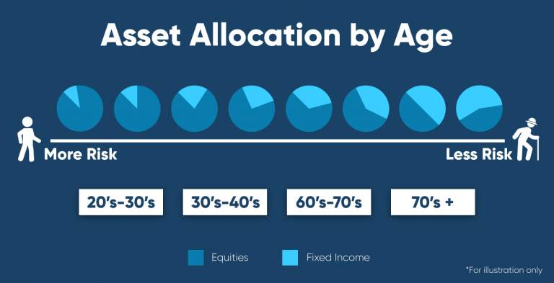
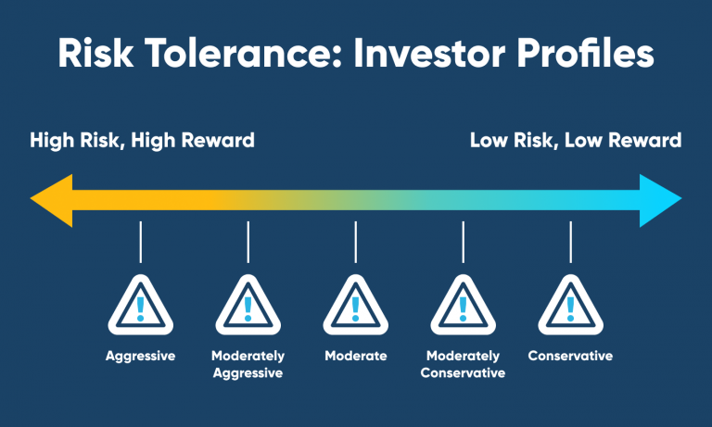
Importance of Asset Classes

Slide 19
General Investing Principles
Rely on Fixed Income instruments for immediate and short-term cashflow
Rely on Equity instruments for long-term growth
Move funds from Equity to Fixed Income periodically to ensure asset re-balancing
Ensure you have adequate health insurance
No need to have a life insurance plan once retired; save on premiums
Plan early from a tax optimization perspective

Slide 20
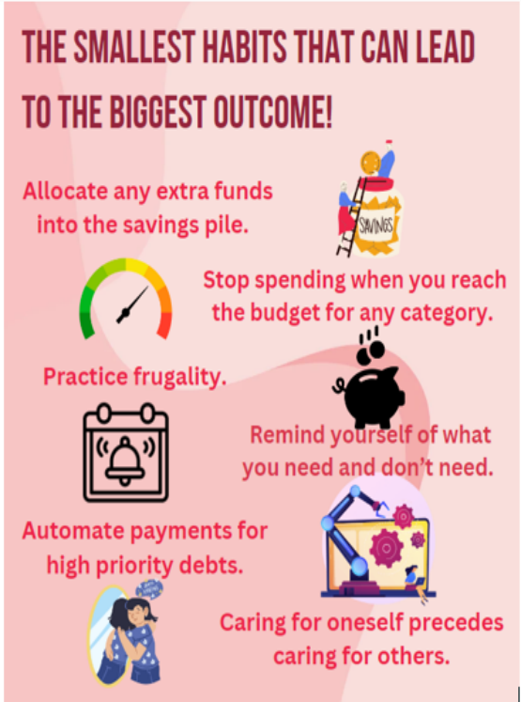
Inculcate Sound Investing Habits

Slide 21
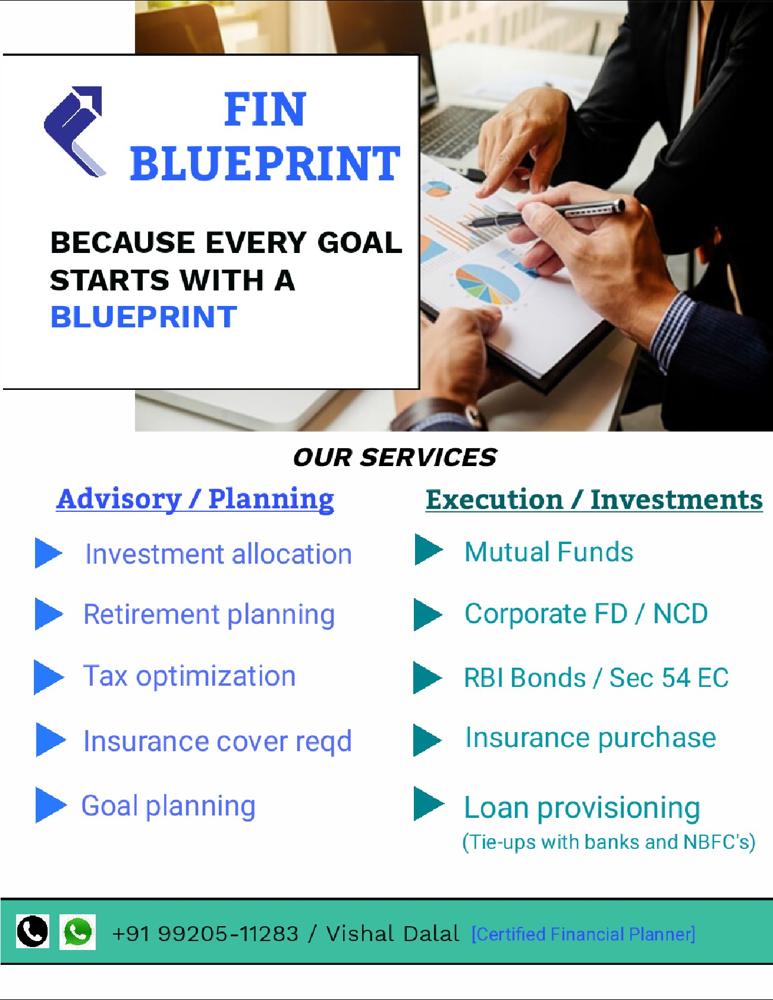

THANK YOU
Contact: +91 99205-11283
Website: www.finblueprint.in
Whatsapp Group: Join

