Slide 1
Fin BluePrint: Reverse Mortgage Overview
VISHAL DALAL – Certified Financial Planner [CFP^{CM}]

Slide 2
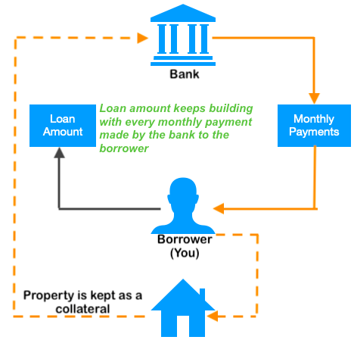
What is Reverse Mortgage?
    Bank makes payments to the borrower / borrowers against mortgage of his / their residential house property
    Provides an additional source of income
    Meant primarily for senior citizens

Slide 3
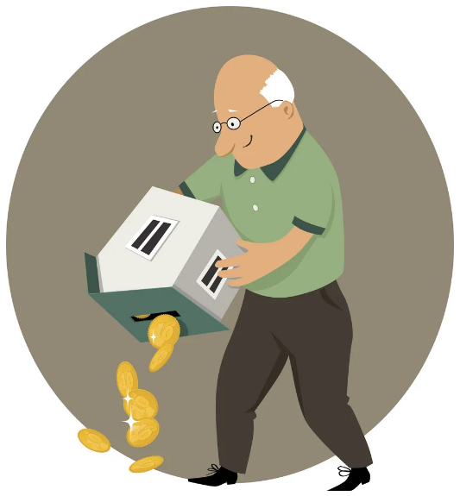
Eligibility
    Citizen of India & Minimum Age of 60 years when single borrower
    In case of joint borrowers, spouse’s age should be more than 58 years
    Own a residential property which is fully self occupied. Commercial property ineligible
    Property should be free from any liability, debt, or other obligations and residual life of property should be greater than tenure of mortgage scheme

Slide 4
Typical Scheme Details
    Loan Tenure: 10-15 years, depends on age of borrowers
    Loan Amount: Between 60-90% of the property value
    The lender re-values the pledged property every five years and increases the quantum of the loan if the valuation rises gradually
    Can avail the reverse mortgage loan as a lump-sum of cash or as a regular monthly / quarterly cash advance
    Your Income Is Not Considered during Loan Sanction
    Payments received from the lender are exempt from tax under Section 10(43) of the Income Tax Act

Slide 5
Some Finer Points
    After the loan tenure is over or the borrower lives longer than the tenure, the lender won’t make any payments, but the borrower can still stay within the house
    House owner house should keep paying all the taxes associated with the property, insure and maintain it as their primary residence
    Property can’t be let out on rent during the time it is on reverse-mortgage
    After the death of the owners, the heirs to the property can either redeem the loan and retain the property or allow the bank to sell it and take the money left after repayment of the loan
    Amount spent on the renewal or repair will be eligible for deduction in computation of income (up to 30,000 on interest paid on loan taken)

Slide 6
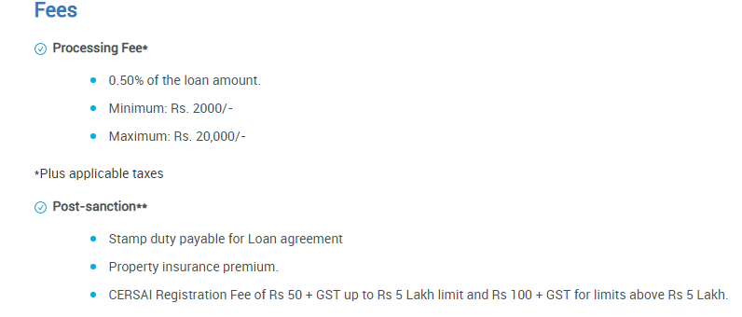
Fees & Charges (SBI)

Slide 7
Documents Required for Reverse Mortg.
    PAN card
    Aadhar card
    Registered Will
    List of Legal Heirs
    Property Details

Slide 8
Reverse Mortgage Amount Calc.
    Contrary to expectations , the amount lent by bank is NOT equal to value of the property. It is the amount that will grow to the loan corpus by the end of the loan tenure
    For example, if you take a reverse mortgage loan for 20 years, the loan corpus is 80 lakhs and the prevailing rate is 12.0%. The bank will pay you 8,000 per month. 8,000 per month for 20 years adds up to 19.2 lakhs only. This is nowhere close to Rs 80 lakhs of the loan corpus
    Why Rs 8,000 and no other number? Simple. If you invest Rs 8,000 per month in an instrument that returns 12.0% for 20 years, you will have Rs 80 lakhs at the end of 20 years
    Monthly payouts will increase if tenure is reduced & interest rate is lower

Slide 9
Drawbacks of Scheme
    Not able to bequeath the house to the next generation
    The maximum tenor of payments is only 20 years. What do you do after that? Can’t rely only upon this as source of post-retirement income
    The yield is too low. For a house that has a market value of Rs 1 crore, you will get Rs 8,000 per month for 20 years. That makes Rs 96,000 per annum. For Rs 96,000 per annum, the bank will take away your house after your demise. Hence, the annual yield is 0.96%
    Other option may be better, especially if it’s not your primary residence – sell the house and use the corpus to get a much higher rate of return. Or purchase a cheaper house to live in with part of the sale money and invest the rest to get returns

Slide 10
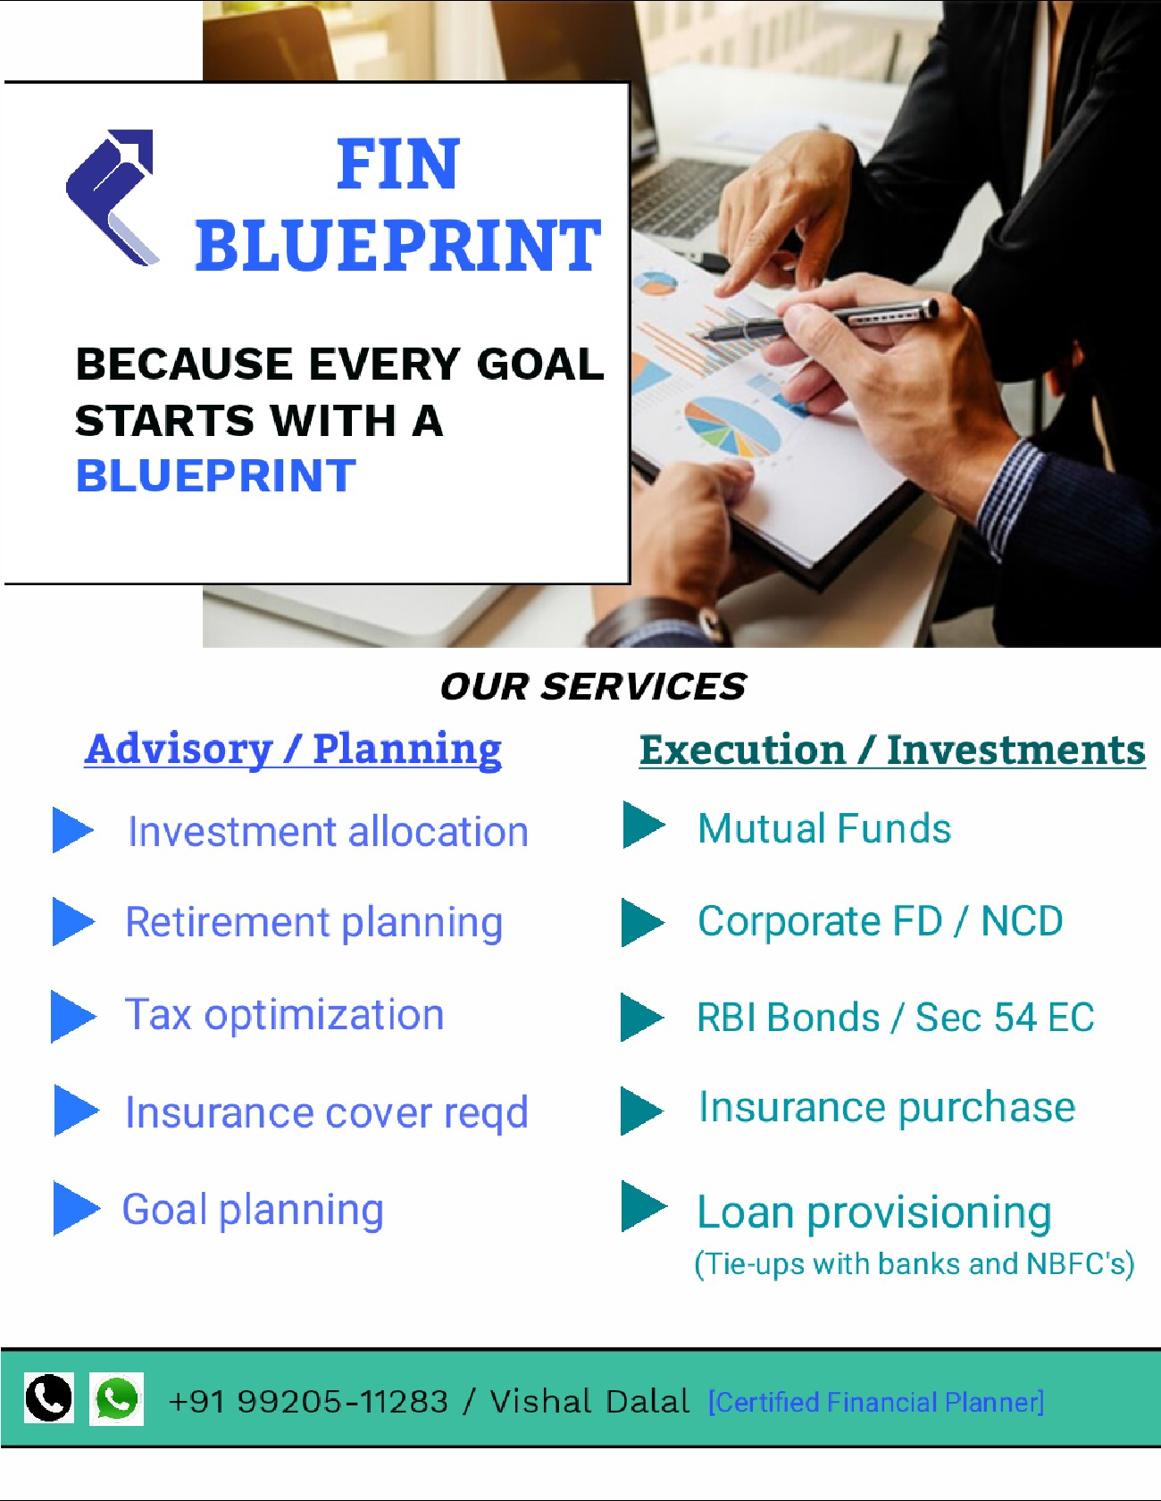

THANK YOU
Contact: +91 99205-11283
Website: www.finblueprint.in
Whatsapp Group: Join

