Slide 1
Fin BluePrint: Common Financial Planning Mistakes
VISHAL DALAL – Certified Financial Planner [CFP^{CM}]

Slide 2

What is a Financial Plan?
  Key Benefits
    Step-by-step approach to meet one’s life goals and acts as a guide as you go through life’s journey
    Helps you be in control of your income, expenses and investments such that you can manage your money
    Most importantly, attain “peace of mind”
  What does it cover?
    Investment Planning
    Retirement Planning
    Insurance Planning
    Contingency Planning
    Tax Planning
    Optimal Asset Allocation
    Ad-hoc / Custom queries

Slide 3
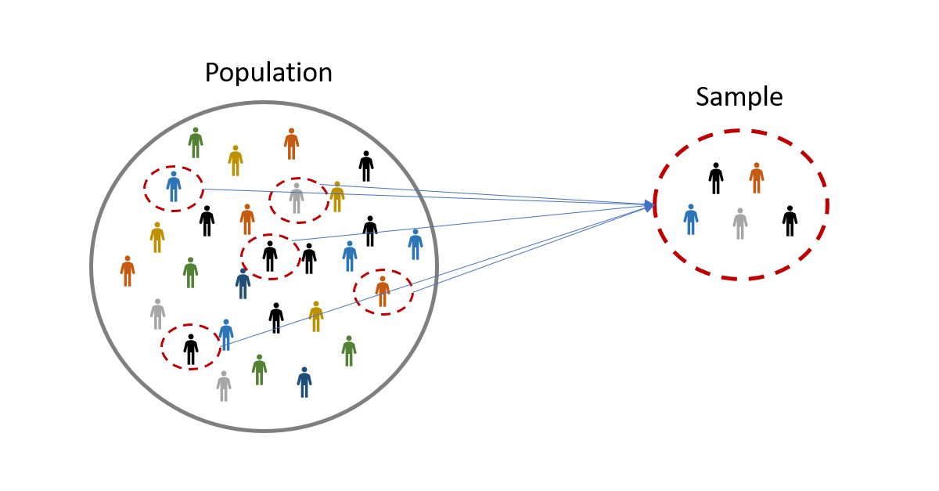
Real-Life Cases
    Sample Size: 25
    Spread across various age groups – 20’s to 60’s
    Single / Couple / Family
    Single / Dual income
    Salaried / Business / Retired
    Comprehensive Plan / Consultation on a specific topic

Slide 4
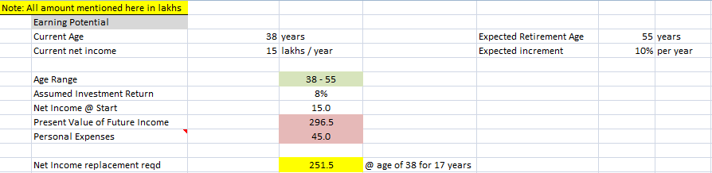
Life Insurance
    100% not aware about the ideal coverage amount for life insurance
    Not aware of calculation required to be able to compute this amount

Slide 5
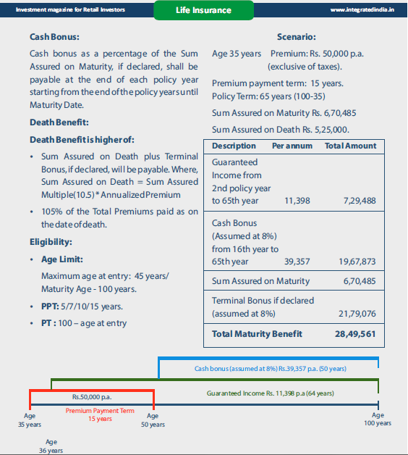
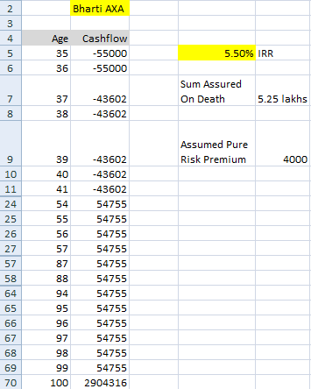
    50% had invested in insurance-cum-investment plans but had no idea about returns. Not aware of surrender value either until too late

Slide 6
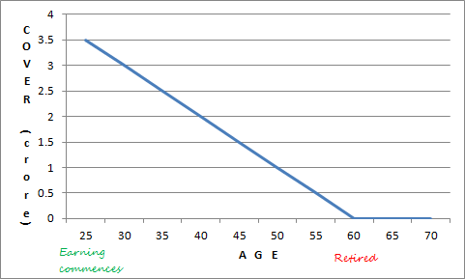
    50% had life insurance cover outside of the correct age band
    25% had a query regarding whether health insurance should be bought during employment when employer is providing cover?

Slide 7

Retirement Planning
    90% wanted to retire early
    Not aware of quantum of retirement corpus and whether it would last till their lifetime
Follow the 3-Step process
Determine your Retirement Corpus
Determine your Risk Appetite
Determine your Deployment Options

Slide 8
Corpus Determination – Scenario
Couple | Both aged 60 years
Current & Projected Expenses @ age 60 | Regular: 50,000 / month, increasing with inflation Bulk: Single child’s marriage @ age 65: 35 lakhs
Expected Income | 20,000 pension / month until life, increasing with inflation
Bequeath to children / family | Existing premises
Inflation | Assumed @ 6% until lifetime
Liespan / Longetivity | Assumed up to 80 years
Risk Quotient & Investment of Corpus | Moderate Allocation: 50% Debt, 30% Equity, 20% Gold

Slide 9
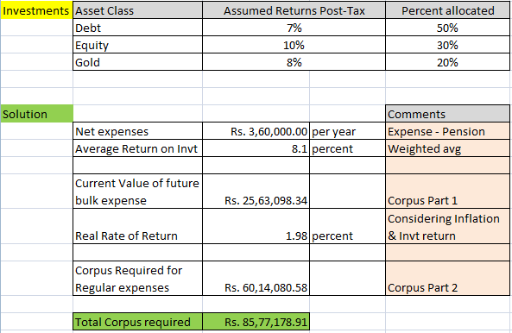
Corpus Determination – Solution

Slide 10
Portfolio Recommendation – Moderate Risk
Product | Periodic Income? | % Allocation | Taxation | Post-tax Returns
Bank Fixed Deposits | Y | 10 | Clubbed with income | 6%
Corporate Bonds AAA / AA | Y | 10 (AAA) + 10 (AA) | Clubbed with income | 6.5%-7.5%
Small Saving Schemes NSC/KVP/PPF/Post-Office | Y* | 10 | 80C benefits, EET, EEE | 6%-7%
Gov / Mun / RBI Bonds | Y | 10 | Clubbed with income | 6%-7%
Mutual Fund (SWP) Debt, Floating-Rate | Y | 20 | Capital Gains LT: 20%** ST: Clubbed | 7%-8%
Mutual Fund (SWP) Equity (Large only) | Y | 30 | Capital Gains LT: 10% | 10%-12%
* Some of them, not all ** With Indexation Debt:Equity = 70:30

Slide 11

Liquidity
    75% did not have enough savings for contingency funding whereas remainder had excess in low-yielding avenues like savings account and fixed deposits
    10% were required to extend the loan tenure due to severe cashflow crunch

Slide 12

Tax
    Most people aware of standard deductions to be claimed such as 80C, interest on housing loan, ELSS
    However, 75% not aware of relatively newer or uncommon avenues such as NPS, claiming HRA by paying rent to family members, use of HUF for tax savings, etc.
    < 5% had tax-friendly policies for their employees

Slide 13
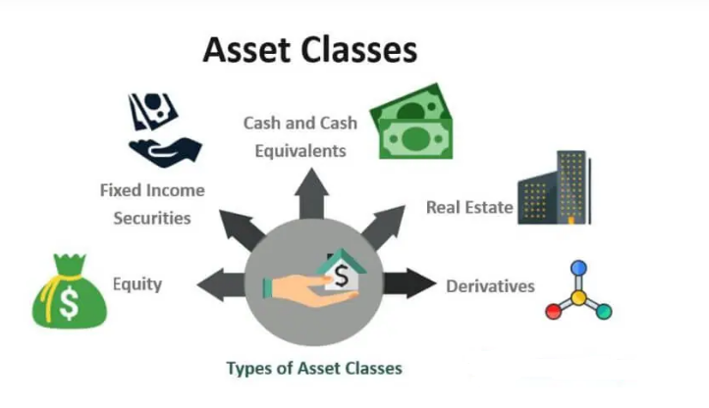
Investments
    100% were under-invested in equity although all were fine with the idea to allocate more to this asset class
    90% unaware of their existing and optimal asset allocation %
    75% unaware of allocation % within Mutual funds - Large / Flexi / Mid / Small / Sector / Global - and risk associated with each

Slide 14


Investments
    50% interested in investing into equities directly but not sure about the amount or where to invest; basically, how to commence investing
    35% lacked conviction in investments made in existing mutual funds
    35% bought into too many mutual funds; 40+ in few cases
    15% had a tendency to monitor mutual funds and / or stocks very frequently and ask for frequent churn
    <15% were interested in learning about other avenues for earning; especially the ones in news and new-age avenues such as crypto and p2p lending

Slide 15

Planning / Others
    Some people left it for too late; had to tell them that they need to work until 65 years at least to be able to retire and meet all their financial goals
    Some did not plan for upcoming large event like birth of a child and impact it would have on their finances
    Some had queries upon a Buy-vs-Rent scenario and what would make more sense for them from an economics perspective

Slide 16
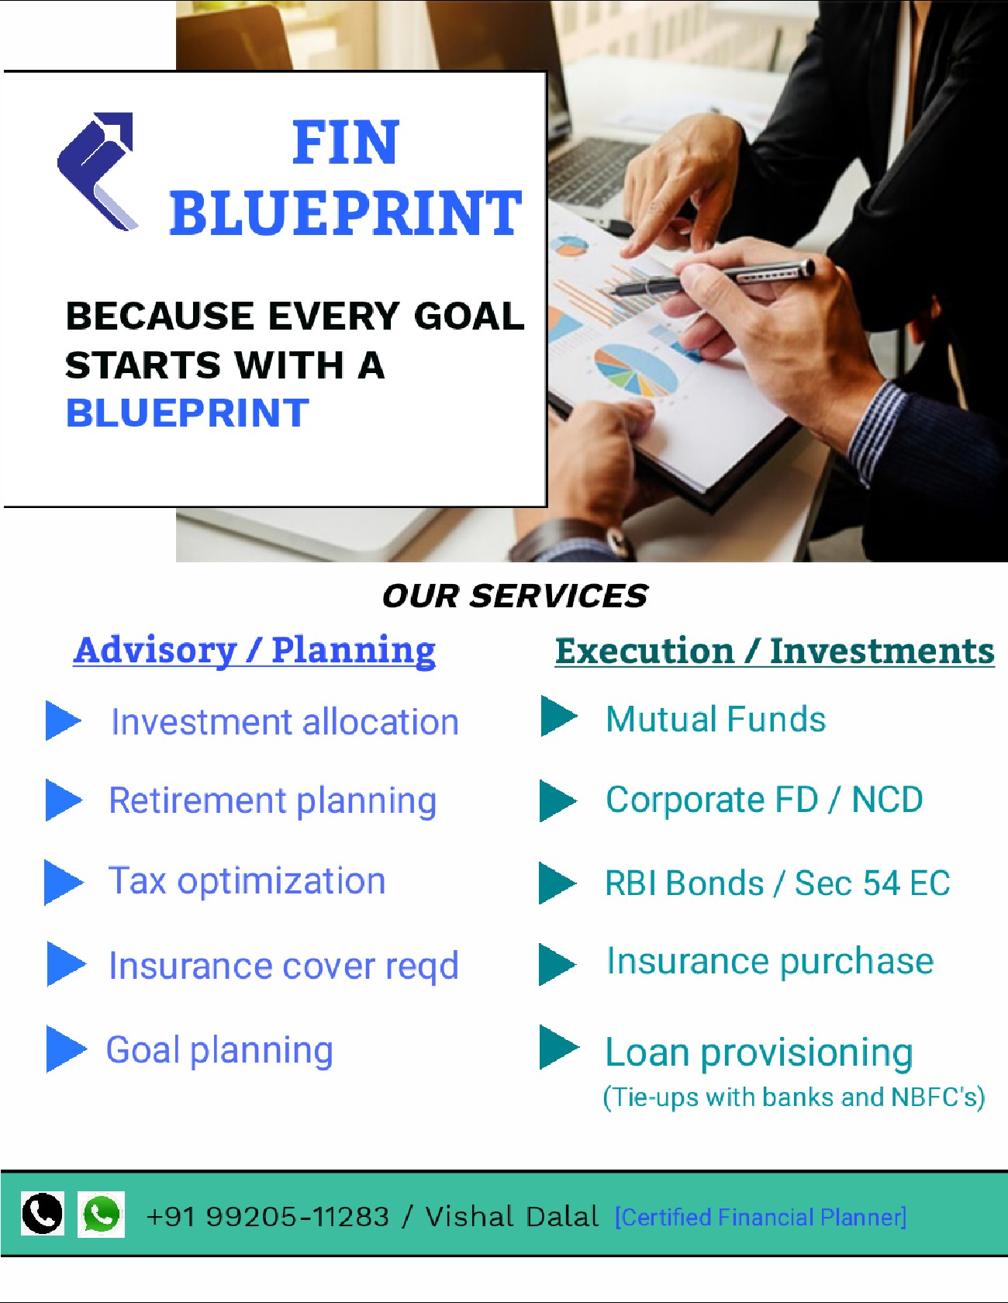

THANK YOU
Contact: +91 99205-11283
Website: www.finblueprint.in
Whatsapp Group: Join

