Slide 1
Fin BluePrint: Life Insurance
VISHAL DALAL – Certified Financial Planner [CFP^{CM}]

Slide 2

Contents
Who requires Life Insurance?
What is the right cover for Life Insurance?
Types of Life Insurance policies
Calculating returns from your insurance policy for non-term plan
Grievance Redressal Mechanisms

Slide 3
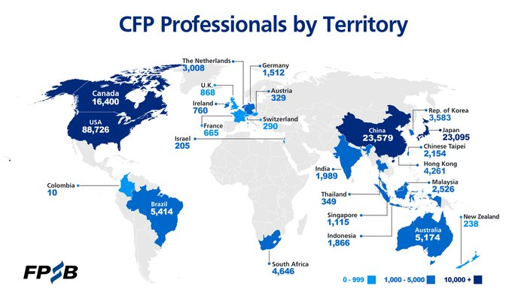
Who are we?
Certified Financial Planner - internationally recognized
24 years corporate experience (17+ in Fortune 500 banks)
IRDAI Certified

Slide 4
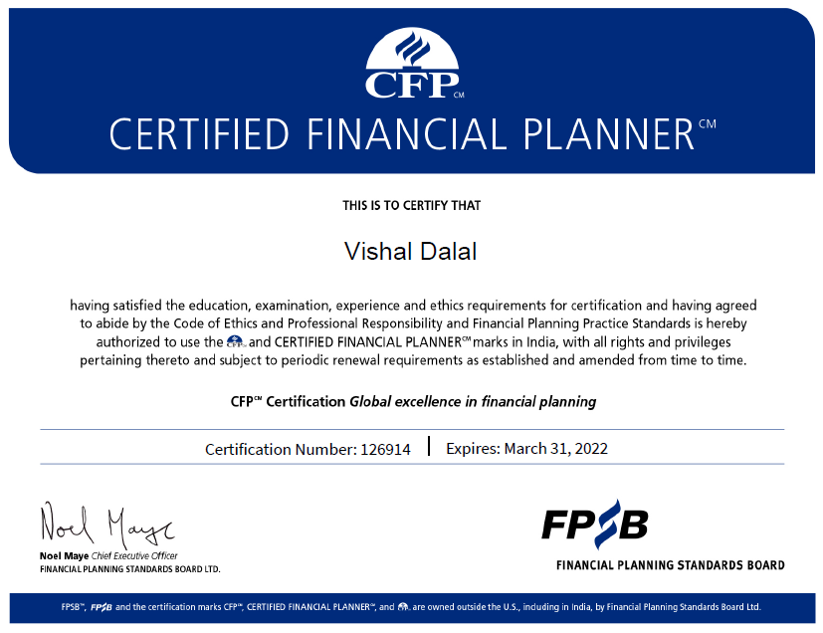

Slide 5
Who requires Life Insurance?
  Back to Basics: What is the purpose of Life Insurance?
      Pure Risk Mitigation - Income replacement for temporary or permanent disability & death
      Not an avenue to serve as additional / supplementary income
      Not an avenue to serve as investment income
  Meant for those who actively earn income because of their own labor or skill - the “Breadwinner” of the family
  Need to support dependents
  Not meant for: Retirees, Children, Housewives, Students, Unemployed, Earner but with no dependents

Slide 6
Insurance Cover Determination
  Rule of Thumb: Between 8 to 15 times of net income depending on your age
  Needs Approach: Based on expenses
  Human Life Value (Preferred)
      Expected earnings over entire lifetime
      Add outstanding liability like home or personal loan
      Subtract expected personal expenses
      Subtract any existing insurance cover (from employer, for ex)
      Account for investment return and expected increase in income in calculation

Slide 7
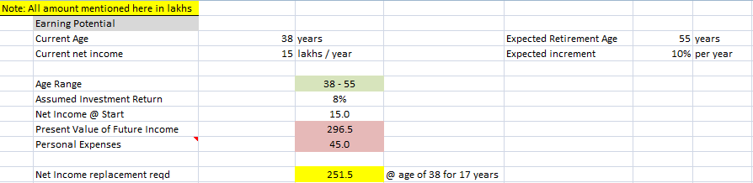
Insurance Cover Determination - Example

Slide 8
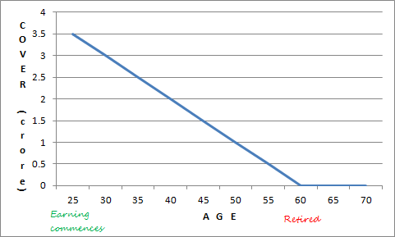
Insurance cover required over time

Slide 9
Types of Life Insurance Policies
  Pure Risk or Term Plan (Strongly Recommended)
    Term Life (with and without return of premium)
  Risk + Investment
    Endowment / Whole Life / Money-Back / Universal / ULIP
    Premium Payment: Single / Part / Full over cover duration
    Payout: Periodic over term / Annuity / Joint-Life
  Additional Riders
    Accidental / Disability / Premium Waiver / Critical Illness

Slide 10
IRR / XIRR
  Traditional formulas don’t work for periodic SIP’s, lump sum investments or ad-hoc incoming and outgoing cashflows
  Both measure annual rate of growth that an investment is expected to generate
  IRR is particularly useful for calculating returns on insurance cum investment products which have periodic cashflows
  XIRR is particularly useful to calculate returns from ad-hoc or lumpy Mutual Fund or stock investments
  Both are extremely simple-to-use formulas in Excel

Slide 11
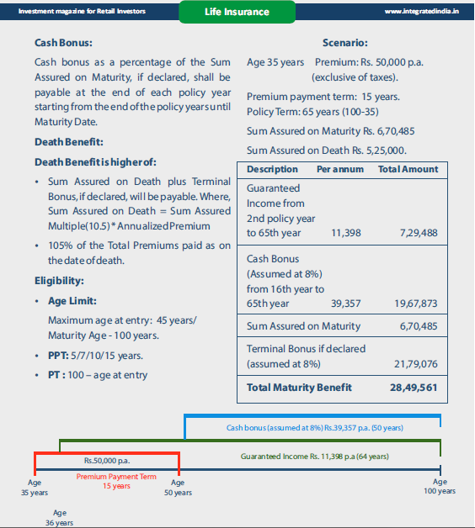
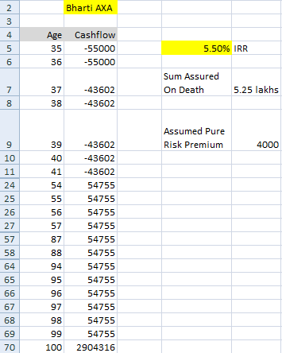
Real-Life Examples (1)

Slide 12
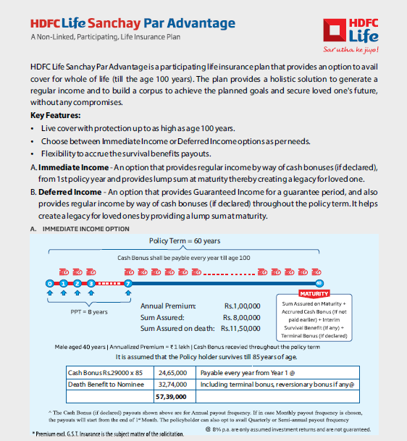
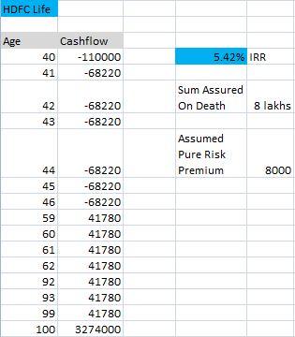
Real-Life Examples (2)

Slide 13
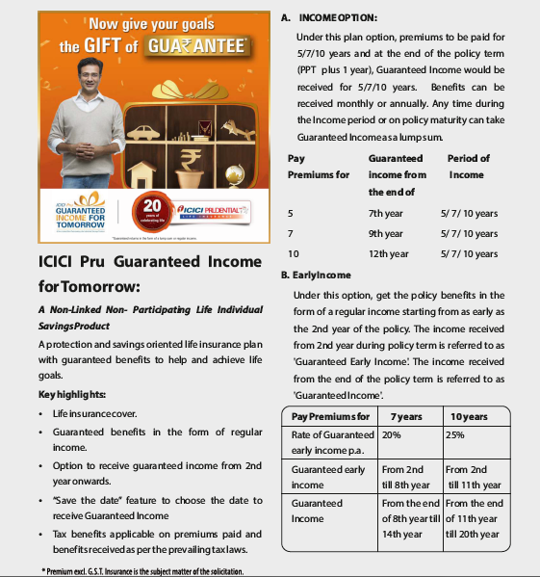
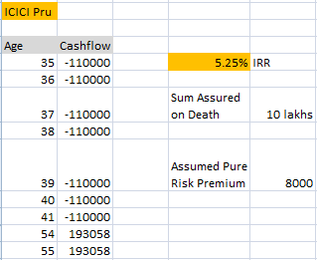
Real-Life Examples (3)

Slide 14
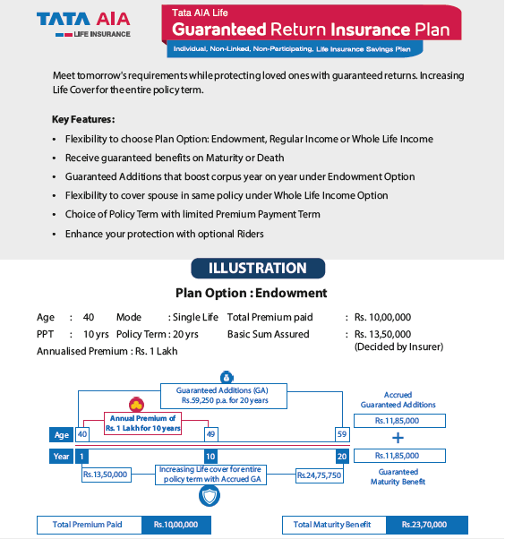
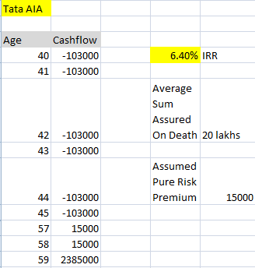
Real-Life Examples (4)

Slide 15
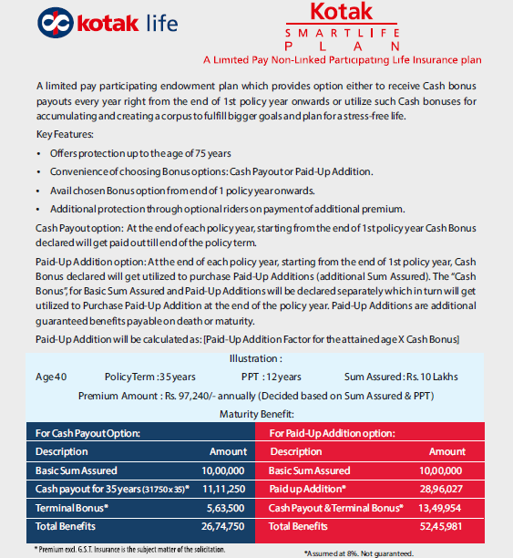
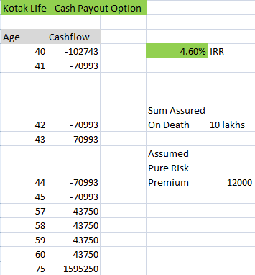
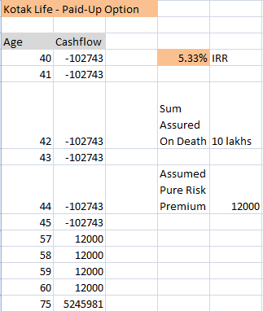
Real-Life Examples (5)

Slide 16
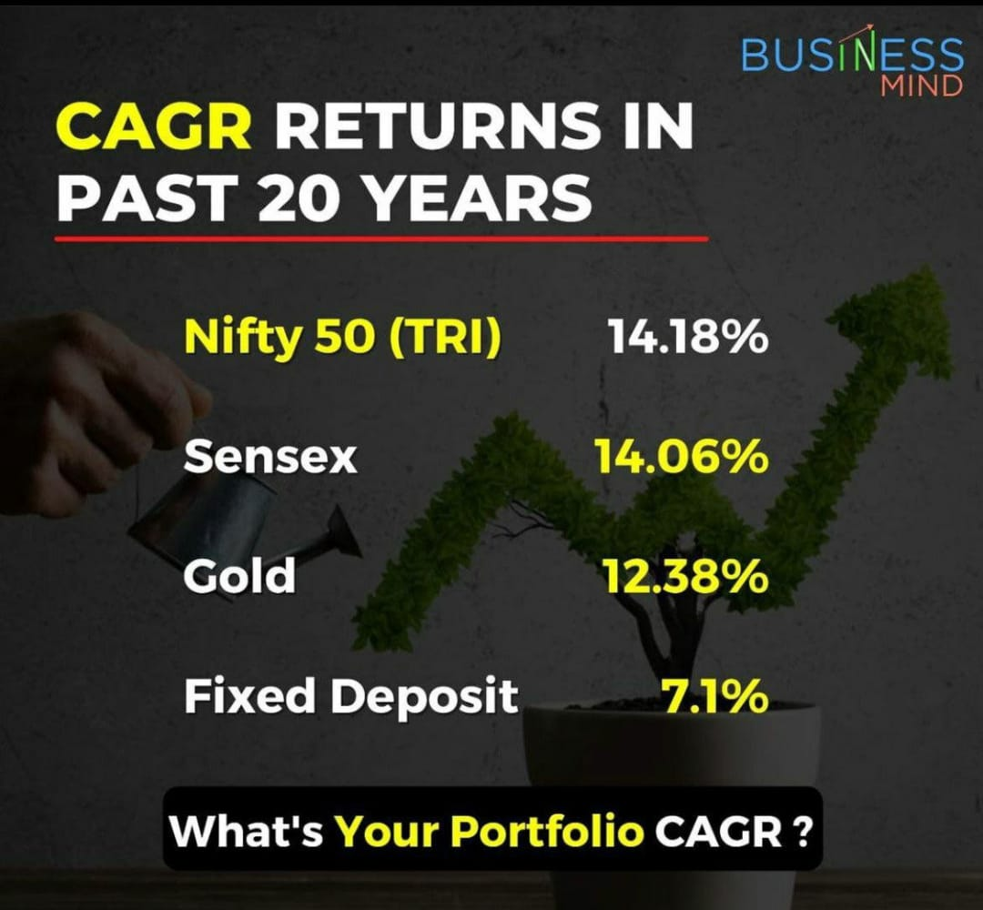
Long-term Returns of other Asset Classes

Slide 17
Grievance Redressal Mechanism
  Integrated grievance management system (IGMS)
    Provided by IRDA
    Policy holders can register on this system with their policy details. Complaints forwarded to the respective insurance company
  Consumer Protection Act 1986
    District forum: Less than 20 lakhs cover
    State commission: 20 lakhs to 1 cr cover
    National commission: Above 1 cr cover
    Procedure for filling a complaint - can be filled personally or by any authorised person
    NO fee for filling complaint. No advocate is needed.
    Nature of complaints – delay in settlement of claims, non settlement of claims, repudiation of claims, policy term & conditions improper etc.

Slide 18
Grievance Redressal Mechanism (cont’d)
  Insurance Ombudsman
    Resolve all complaints relating to settlement of claim on the part of insurance companies in a cost effective, efficient and impartial manner
    The ombudsman by mutual agreement of the insured and the insurer can act as a mediator and counsellor within the terms of reference
    All complains must be made in writing
    Awards by ombudsman – the awards should not be more than Rs.20 lakhs, the award should be made within a period of 3 months from date of receipt of complaint
    Insurance Ombudsman operates only within the specified territorial limits
    The Insurance Ombudsman needs to be approached within one year of rejection of the complaint by the insurer

Slide 19


THANK YOU
Contact: +91 99205-11283
Website: www.finblueprint.in
Telegram Group: Join

